Slide 1
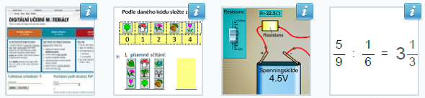
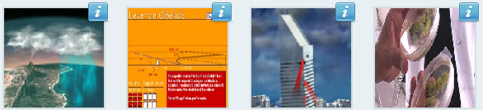
Learning Resource Exchange http://lreforschools.eun.org
David Massart, European Schoolnet

Slide 2
Outline
European Schoolnet
Learning Resource Exchange
Findings from the ASPECT project
iTEC and the future classroom

Slide 3
What is European Schoolnet (EUN)?
Network of 31 Ministries
of Education in Europe
Dedicated to
(according to the status when created)
Support schools in
bringing about the best use
of technology in learning
Promote the European
dimension in schools
and education
Improve and raise
the quality of education
in Europe

Slide 4
Remit
refocused according to recent internal discussion
Transformation of Teaching and Learning Processes
How ICT and Digital Media contribute

Slide 5
EUN stakeholders and target groups
Stakeholders
Target groups
Ministries
of Education
Teachers, Pupils
European
Commission
School Leaders
European
Schoolnet
IT Industry
and Suppliers
Policy makers
Schools
Researchers
Developers
Experts

Slide 6
EUN specific objectives
Fosters and supports
collaboration and cooperation
among schools in Europe
Offers pedagogical and
information services with
European added value
to schools in Europe
Supports professional
development of
teachers and school heads
Contributes to development
of technology-enhanced
learning in schools
Disseminates good practice
and investigates new
models for schooling
and learning
Provides services, content
and tools based on ICT
to members and
partner networks

Slide 7
EUN activities
Think tank
Peer exchange platform
Changing practice platform
Evidence-base & knowledge building platform
Policy and Innovation Committee (PIC)
Studies & surveys
Action research projects
Cooperation & collaboration projects
Thematic working groups and committees
Brokering of existing research results
R&D projects

Slide 8

Support to schools and teachers
eSafety
Teachtoday
Insafe
School networking
MST /STEM
eSkills
Xplora
ECB (MST platform)
Intelligent energy
International
education network
International
cooperation
Competitions &
campaigns
eLearning Awards
Euro competition
Community
of practices
(teachers, pupils)
eTwinning, games, LRE

Slide 9














EUN & Content-Related Projects
Notes:
9
sqdsdS

Slide 10
A Little Bit About Myself
LRE Program Manager @ EUN
Interoperability & Standards
  IMS Global Learning Consortium
  IEEE Learning Technology Standard Committee
  CEN TC-353 & WSLT
Recent projects
  ASPECT: http://aspect-project.org
  iTEC: http://itec.eun.org

Slide 11

Learning Objects, Metadata, and Repositories
Notes:
Learning Object:
Anything digital used for learning and/or teaching
Learning Object Metadata:
Machine-readable description of learning resources
Learning Object Repository:
Software system for managing learning resources and their metadata

Slide 12

Learning Objects, Metadata, and Repositories
Notes:
Learning Object:
Anything digital used for learning and/or teaching
Learning Object Metadata:
Machine-readable description of learning resources
Learning Object Repository:
Software system for managing learning resources and their metadata

Slide 13

Learning Objects, Metadata, and Repositories
Notes:
Learning Object:
Anything digital used for learning and/or teaching
Learning Object Metadata:
Machine-readable description of learning resources
Learning Object Repository:
Software system for managing learning resources and their metadata

Slide 14

Learning Objects, Metadata, and Repositories
Notes:
Learning Object:
Anything digital used for learning and/or teaching
Learning Object Metadata:
Machine-readable description of learning resources
Learning Object Repository:
Software system for managing learning resources and their metadata

Slide 15

Learning Objects, Metadata, and Repositories
Notes:
Learning Object:
Anything digital used for learning and/or teaching
Learning Object Metadata:
Machine-readable description of learning resources
Learning Object Repository:
Software system for managing learning resources and their metadata

Slide 16

Learning Objects, Metadata, and Repositories
Notes:
Learning Object:
Anything digital used for learning and/or teaching
Learning Object Metadata:
Machine-readable description of learning resources
Learning Object Repository:
Software system for managing learning resources and their metadata

Slide 17

Learning Objects, Metadata, and Repositories
Notes:
Learning Object:
Anything digital used for learning and/or teaching
Learning Object Metadata:
Machine-readable description of learning resources
Learning Object Repository:
Software system for managing learning resources and their metadata

Slide 18

Learning Objects, Metadata, and Repositories
Notes:
Learning Object:
Anything digital used for learning and/or teaching
Learning Object Metadata:
Machine-readable description of learning resources
Learning Object Repository:
Software system for managing learning resources and their metadata

Slide 19
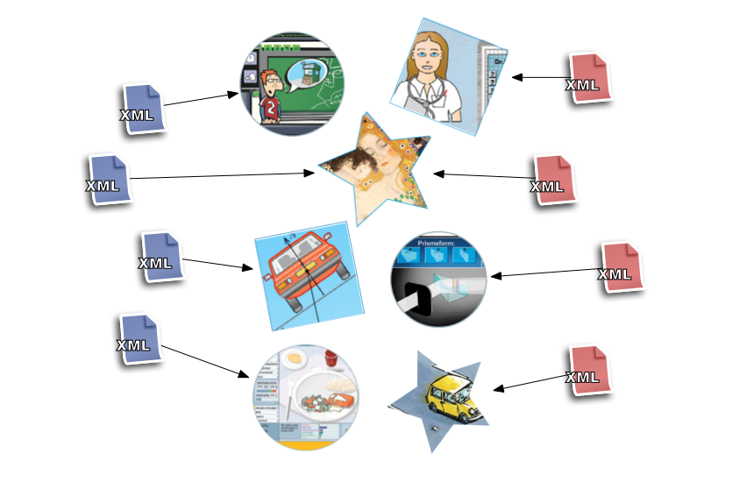
Learning Objects, Metadata, and Repositories
Notes:
Learning Object:
Anything digital used for learning and/or teaching
Learning Object Metadata:
Machine-readable description of learning resources
Learning Object Repository:
Software system for managing learning resources and their metadata

Slide 20
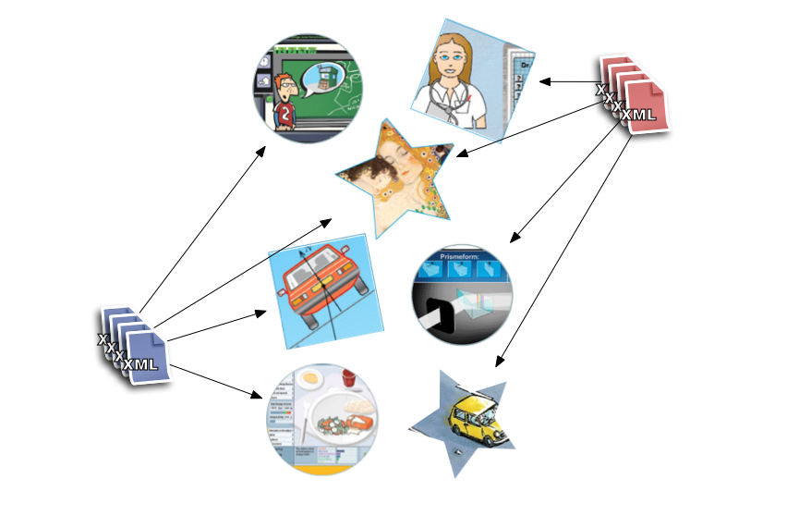
Learning Objects, Metadata, and Repositories
Notes:
Learning Object:
Anything digital used for learning and/or teaching
Learning Object Metadata:
Machine-readable description of learning resources
Learning Object Repository:
Software system for managing learning resources and their metadata

Slide 21
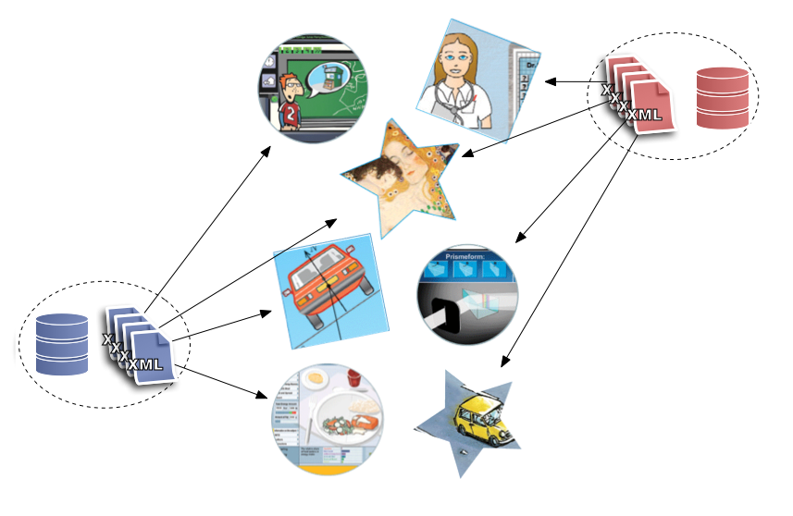
Learning Objects, Metadata, and Repositories
Notes:
Learning Object:
Anything digital used for learning and/or teaching
Learning Object Metadata:
Machine-readable description of learning resources
Learning Object Repository:
Software system for managing learning resources and their metadata

Slide 22
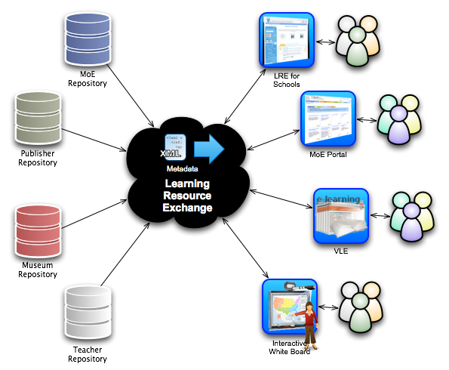

Slide 23
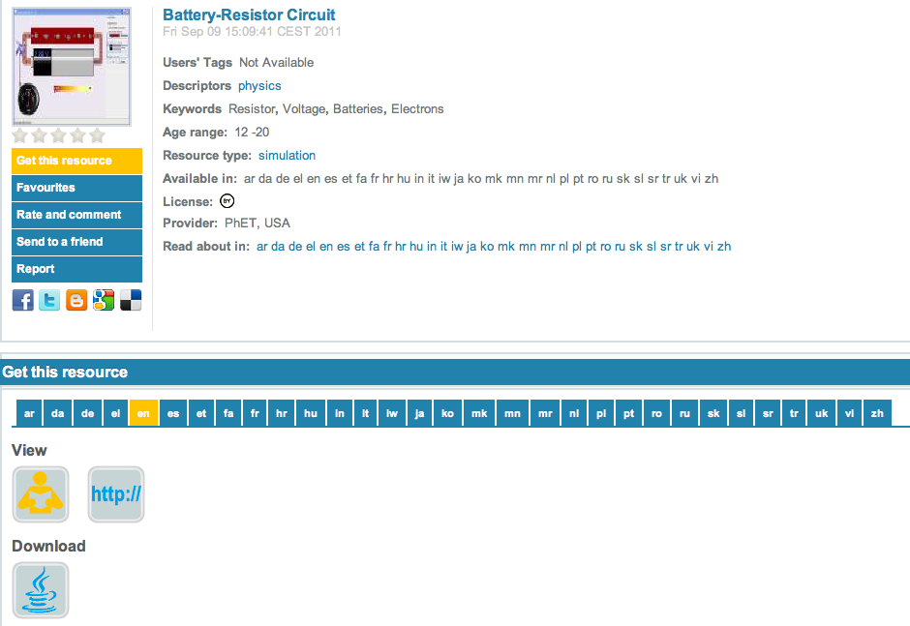
LRE Metadata Application Profile http://lreforschools.eun.org/web/guest/metadata

Slide 24

50+ LRE Content Providers http://lreforschools.eun.org/web/guest/content-providers

Slide 25
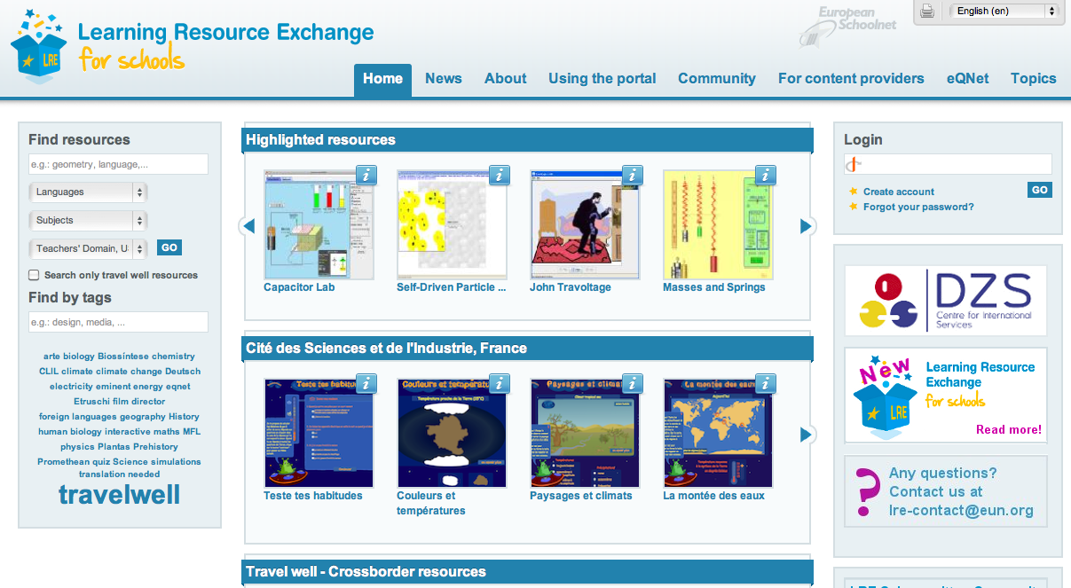
LRE Portal http://lreforschools.eun.org/

Slide 26
LRE Subcommittee
LRE governing body
Meets twice a year
Founding members and Associate members have one vote each and elect a Chair
Technical Advisory Board – chaired by EUN
Decisions on operation of LRE and annual workplan decided by Founding and Associate partners
Changes to statutes of LRE Governing Committee and LRE members ship rules require majority decision by Founding members (MoE)
Option to terminate LRE development and maintenance

Slide 27
Types of LRE partners
LRE Founding partners – MoE
LRE Associate partners
  Territorial, regional, municipal authorities
  Commercial and public sector content providers
  Tools’ providers
LRE Subscription members
  Smaller organizations exploring LRE added value
LRE Affiliate partners
  Do not pay a membership fee or have voting rights
  e.g., PhET
Notes:
27

Slide 28
ASPECT
Developing best practice approaches
To implementing standards and specifications
For both educational content discovery and use

Slide 29
From Content Discovery
To Content Use
Content or user exchange?
Reusable content (e.g., SCORM, IMS CC)
  Content is moved to users’ systems
  Users use their systems of choice
Locked content (e.g., SSO)
  Content is hosted on a system that controls access to it
  Users are moved to the system that hosts the content they are interested in

Slide 30
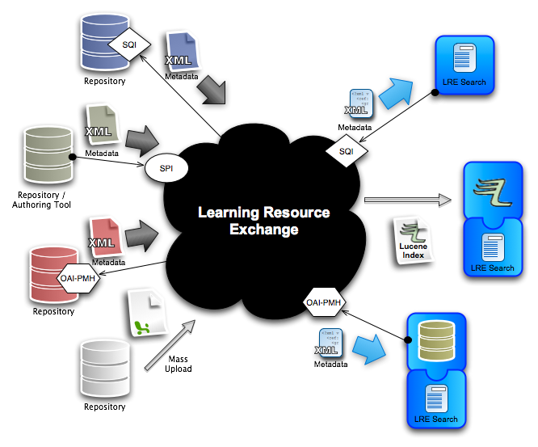
Content Discovery Specifications

Slide 31
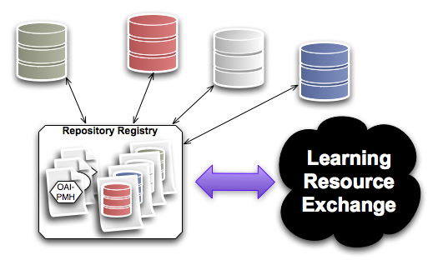
Finding Repositories

Slide 32
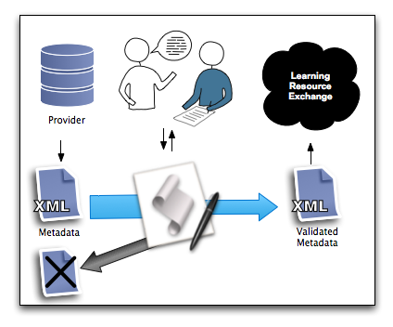
Conformance Testing

Slide 33
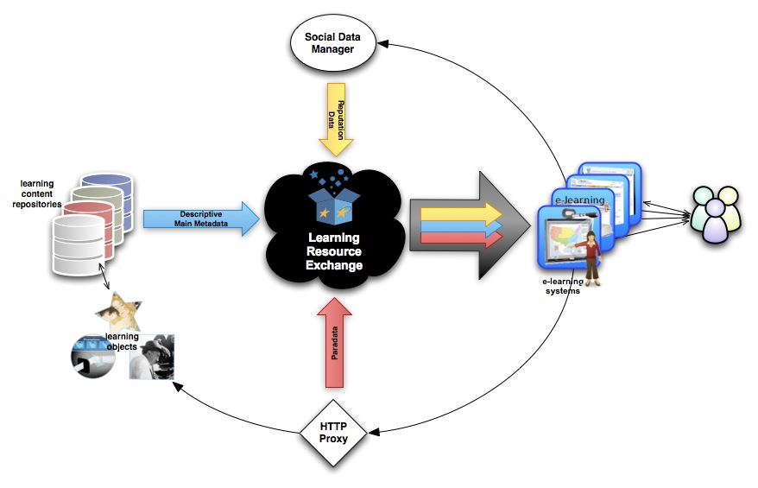
Beyond Metadata
Notes:
IMS ILOX as a framework to manage and exchange “authoritative” and “non-authoritative” metadata of different natures and origins in a conceptually clean way.

Slide 34
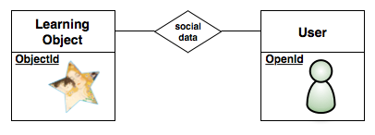
Content and User Identity

Slide 35
Contribution to Specifications
IMS Learning Object Discovery & Exchange
IMS Common Cartridge
CEN EN Simple Publishing Interface
CEN EN Simple Query Interface
CEN WSLT Simple Publishing Interface
CEN WSLT Interoperability of LOR Registries
NSDL Paradata

Slide 36

SCORM

Slide 37
Common Cartridge

Slide 38
Innovative Technologies for an Engaging Classroom (iTEC)
http://itec.eun.org
The iTEC project has been specifically designed to engage policy makers, researchers, technology suppliers and innovative teachers in jointly building ambitious scenarios for the future classroom that have the capacity to influence educational reform processes at both national and European level. With the involvement of 14 Ministries of Education, iTEC has the potential to be a flagship project for the design of the future classroom and a model for how to integrate, introduce and support a new generation of innovative tools. It will also have an impact, not only on those MoE directly involved in the project, but also on the ICT strategies of all 31 MoE participating in European Schoolnet.

Slide 39
iTEC
The iTEC technology approach aims at making the technical components, (people, tools, services and content) required by the scenarios, interoperable and discoverable, so that teachers can more easily select and combine relevant components tailored to the future classroom scenario of their choice

Slide 40
Shell and Widgets
Shell: Educational software that supports learning activities by providing access to resources (e.g., application, content, device, person) mainly via widget technology
As a result of this pedagogical vision, we foresee that all resources – in one way or another – become eventually represented by widgets

Slide 41

What is an iTEC Shell?

Slide 42
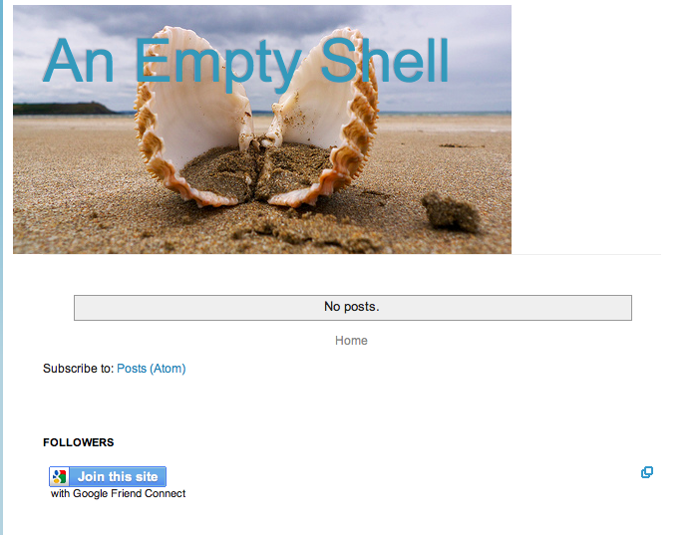
A Shell Can Be Very Simple (e.g., Blog)
Notes:
http://outrouver.blogspot.com/2011/09/more-shells.html

Slide 43
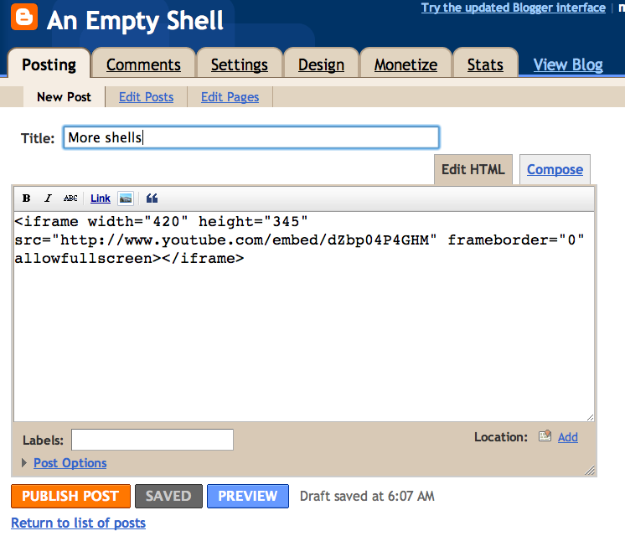
That You Can Complete

Slide 44
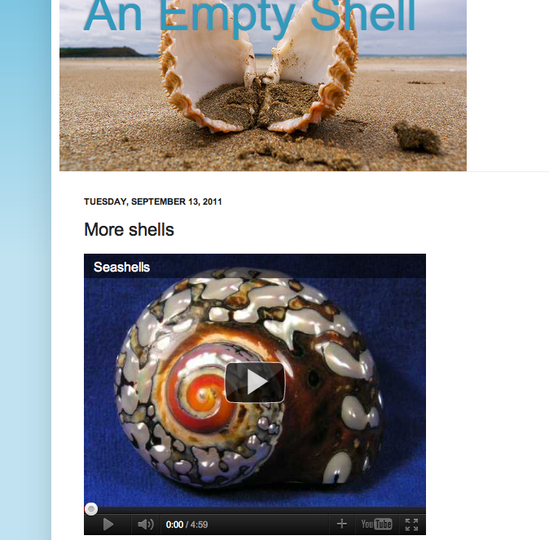
By Embedding Things (e.g., a Youtube Video)

Slide 45
A Shell Can Be
A blog
A Content Management System (e.g., Liferay)
A Learning Management System (e.g., Moodle)
A mobile device (smart phone, tablet)
An interactive whiteboard
Anything that accepts widgets

Slide 46
Things To Embed Include
Content
  Videos, images, google maps, etc.
  Learning material (e.g., IMS Common Cartridge)
Widgets
  Apps
  Other (widgetized) resources
    People
    Events
    Learning Stories
    Etc.

Slide 47
Composer and Learning Stories
Composer: Authoring tool that supports the composition of learning stories enriched by resources made available via the iTEC Widget Store
Learning stories created can be re-used for semi-automatic customization of a shell to support learners in achieving their educational objectives

Slide 48
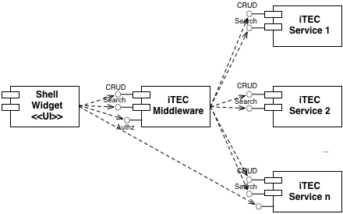
iTEC Architecture (Overview)

Slide 49
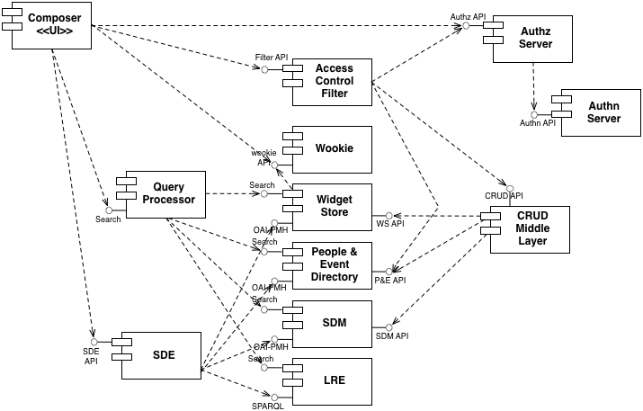
iTEC Architecture

Slide 50
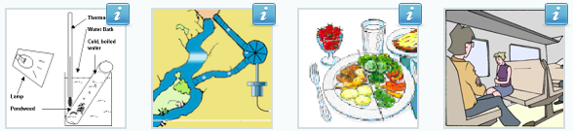
For Further Information
WEB:
http://lreforschools.eun.org
EMAIL:
David.Massart@eun.org

Slide 51
